Slide 1
Models and Particles in XNA

Slide 2
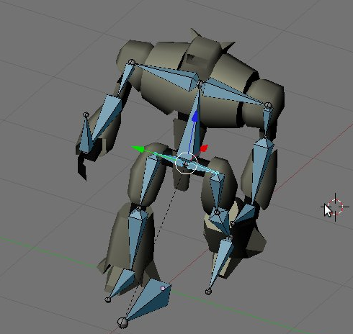
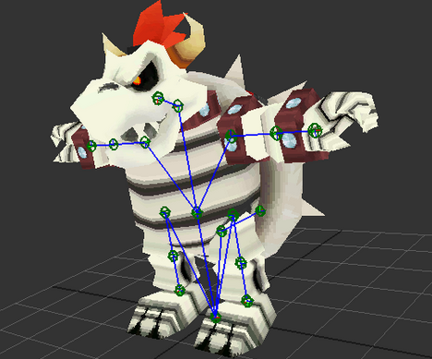
How Animations Work
Mesh Information
Vertices
Bone weights
Skeleton Information
Difference between blender representation and code (see pictures)
Series of Bones
Bones deform vertices when they translate / rotate

Slide 3
How Animations Work
What your code needs to do
Update bones
Current animation
Time
Draw mesh
Deform vertices
Mesh.draw()

Slide 4
Xna Specifics
.FBX or .X
FBX is the most common, but XNA has problems
Only allows one animation per file
Problems solved by custom content processor!
You can tell XNA to compile a model with a specific processor
Split up animations into different files; each file contains exactly one animation
At compile time, take the mesh data from the first file, the animations from all the other ones, and merge into one Model object

Slide 5
XNA Specifics
What you have to do
Already have the code for handling model processing, as well as handling animations in game (thanks mostly to Shawn Hargreaves)
First, Add correct references
Right click on references -> Add Reference->Browse to project file or .dll
Add SkinnedModelLib to SkinnedAnimationPipeline
Add SkinnedModelLib to your main project’s references
Add SkinnedAnimationPipeline to the Content Project (the one containing your models)
Use the .dll in the debug folder]
Go to the model you want
Set the Content Processor field to “Skinned/Animated Model Processor”
In the MergeAnimations field, manually type in the file names for your other animations
Rotate correctly at compile time! (if it compiles and runs, but looks like something from a horror film, it probably needs to be rotated on its Y axis by a multiple of 90 degrees because of Blender to XNA issues)

Slide 6
Code Demo
Import model and adjust settings
Code in MainGame.cs and AnimatedModelComponent(load model, update and draw)
Code in PlayerController.cs (PlayAnimation method)
Run code

Slide 7
Custom Shaders
To write your own shader effects, you have to take apart Microsoft’s stock SkinnedEffect shader and throw your code in where appropriate
Show Shader code
Demo shader code (change to CustomSkinnedEffect in InitPlayer)

Slide 8
Attached Models
Attach an unanimated model, such as a sword, to an animated character model
Get the name of the bone you want to attach it to (hopefully the skeleton was named something sensible)
Multiply the world transform by the animated model’s bone transform
Show code in AnimatedModelComponent.cs

Slide 9
Particle Systems
Use Microsoft’s
Microsoft provided an example of rendering particle systems with the GPU
Updates particle position/rotation/color in a shader (GPU) instead of on the CPU. Super efficient
Spawning particles vs. adding an emitter
Can spawn many particles instantly at one point, or attach an emitter to something and tell it to spawn so many per second
Code in MainGame.cs (ParticleManager init, AddParticle in Update, AddEmitter in InitPlayer)

